Slide 1

FireSDSS Command and Control System for fire in the city centre of Delft
Spatial Decision Support for Planning and Crisis Management
GEO1005 (2015-16 Q2)
Authors:
Evangelos Theocharous - 4515226
Magdalini-Styliani Tryfona - 4516346
Yueqian Xu - 4483952
Instructors:
Sisi Zlatanova
Jorge Gil

Slide 2
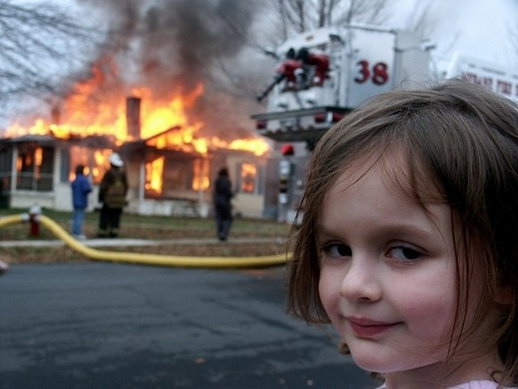
Scenario
A fire incident is reported by civilians at a commercial building in a central area in Delft.
The scenario contains little Marry, who set a building on fire in the centre of Delft. The Command Centre picks up the information in order to inform and coordinate the Police, Fire brigade and Medic teams.
The plugin is solely concerned with the Fire brigade coordination. Tasks included are:
shortest route calculation
location of water sources
computation of the threatened area depending each time on the spread of the smoke

Slide 3





Implementation platform:
QGIS
Qt Designer
Pycharm
Github
Windows
Operating systems:
Windows & Mac

Slide 4
Components of SDSS
Command Centre
Visualization
Maps
Evaluation
Analysis
Spatial
Non-Spatial
Simulation
GUI
Interaction
Information
Data Management
Reporting

Slide 5
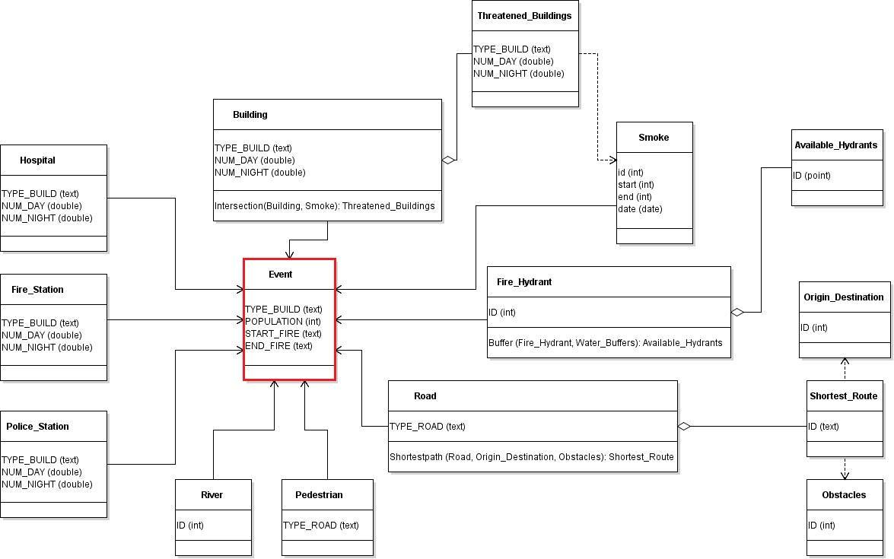
Information Data Management
Input:
The data required are (shapefiles):
Building, polygons
Road, polylines
Pedestrian routes, polylines
River, polylines
Fire hydrants, points
Fire station, polygon
Fire event, polygon
Smoke, polygons
Obstacles, polygons
*All data must be inputed as shapefiles
(*.shp) of the type mentioned.
Other data:
Buildings land use
Residents
Output:
Layers:
Shortest route, polyline
Threatened area, polygons
Available hydrants, points
Water buffer, polygon
Other output:
The map can be saved as image(*.png).

Slide 6
Analysis
Spatial Analysis:
Functions :
Shortest path
Buffer
Intersection
Non-Spatial Analysis:
Functions :
Buildings land use
Residents

Slide 7
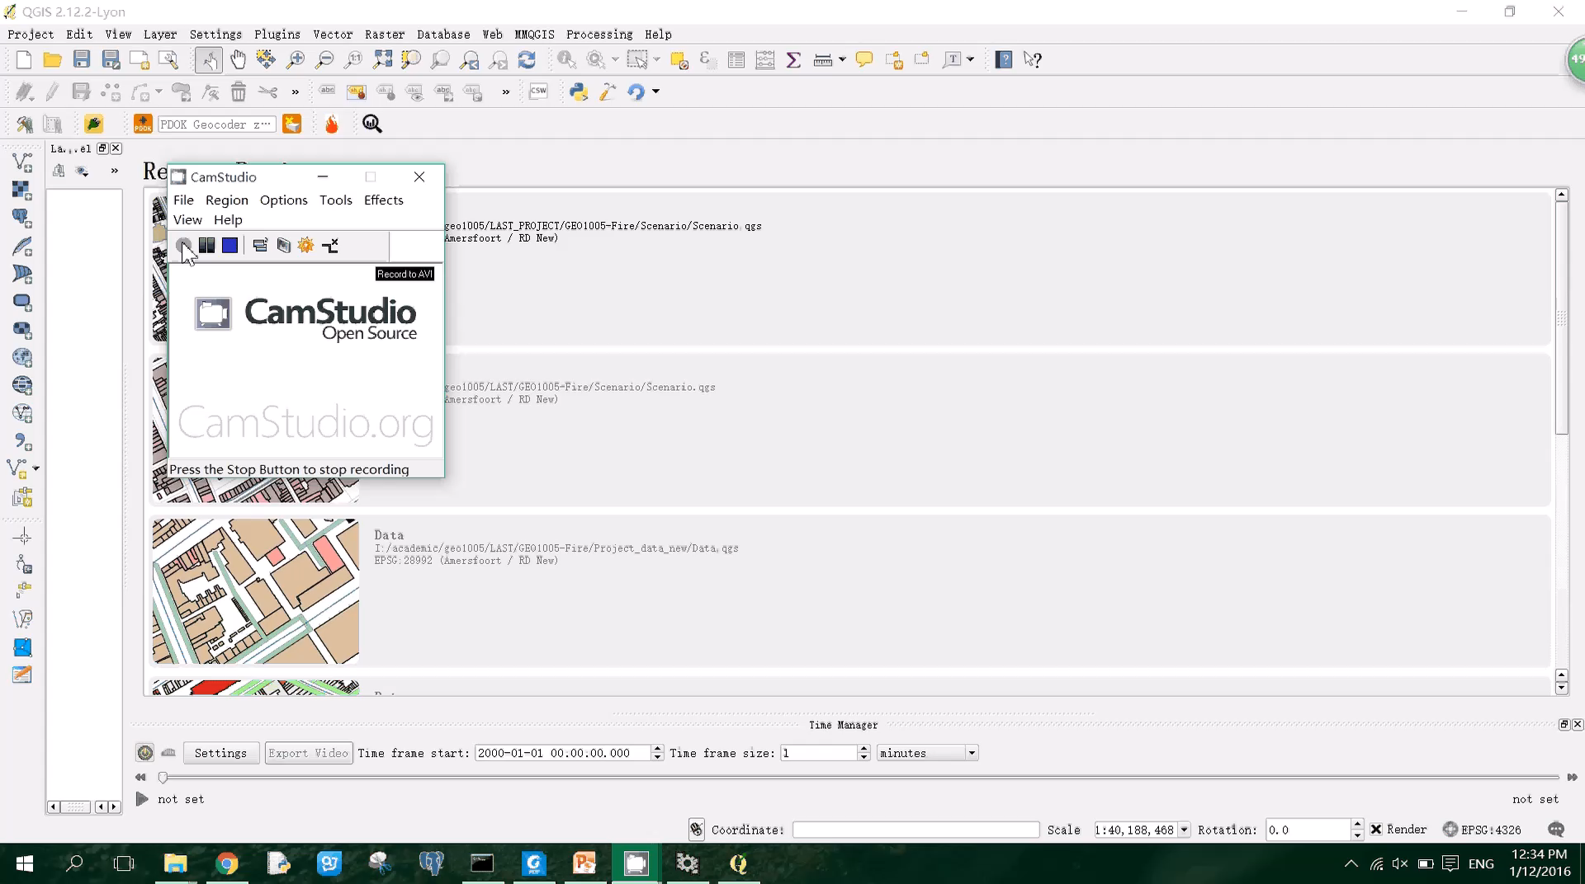

Slide 8
Future Development
Complement the plugin with Police and Medic Services.
Make the fire event to be defined by the user.
Make the obstacles to be defined by the user through the user interface.
Simulate the smoke through real weather data.
Highlight the important buildings that need evacuation (risk factor).
Produce safe evacuation routes and available shelters.
Connect the plugin with census database.
Produce a report containing the before and after the event situation.

Slide 9
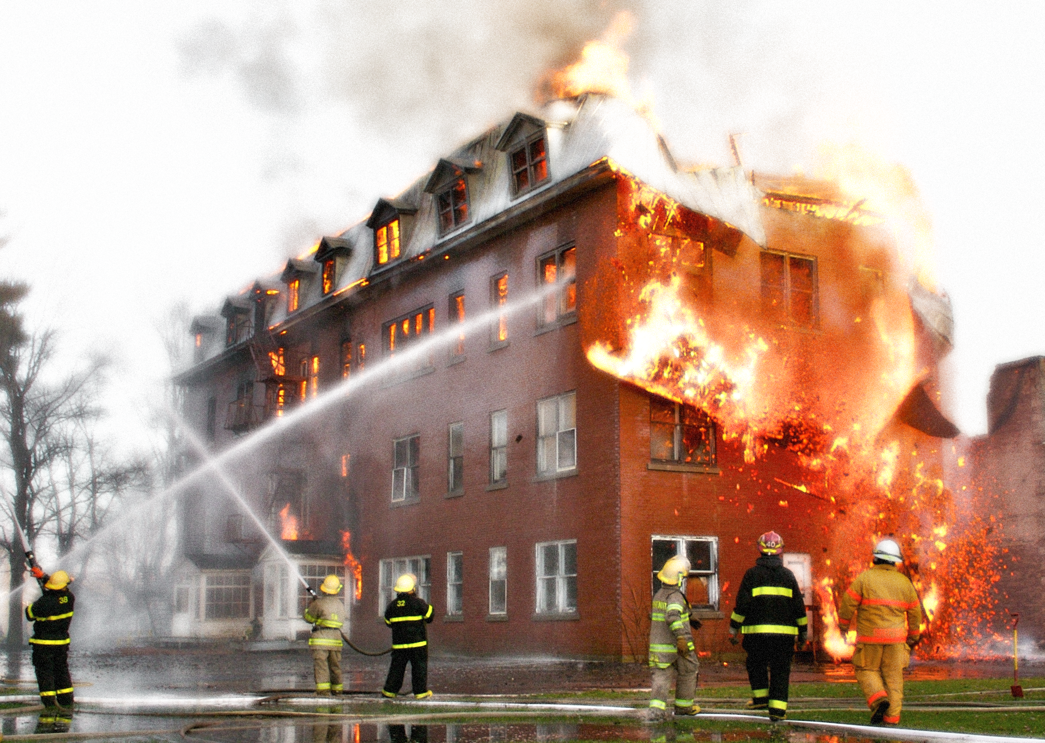
Acknowledgment
Sisi Zlatanova
Jorge Gil
Thank you for your attention !

